Slide 1

Introduction to Cybersecurity

Slide 2

Course Introduction

Slide 3
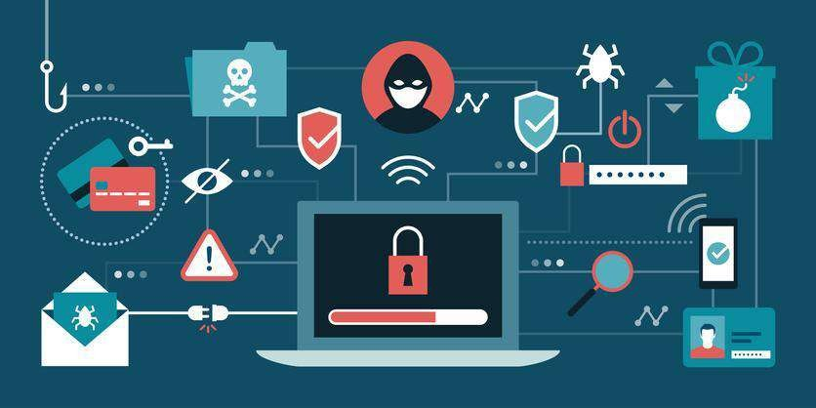
What Is Cybersecurity?
Cybersecurity refers to a set of techniques, used to protect the integrity of networks programs
and data from attack damage and unauthorized access.

Slide 4
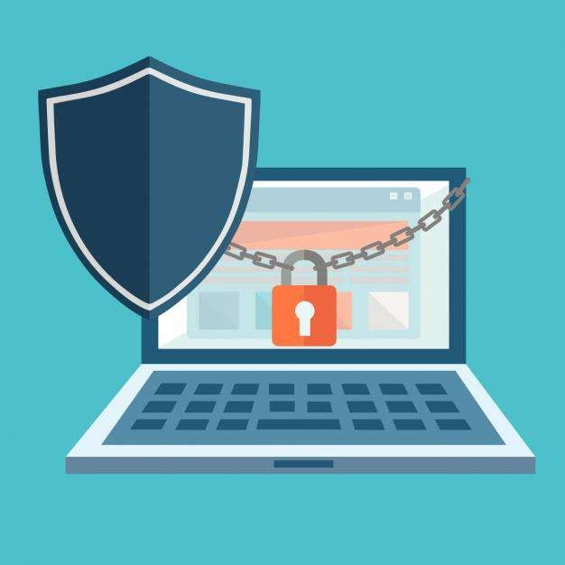
Why Cybersecurity?
Addresses business objectives and IT security interdependency
Focuses on organizational information security management

Slide 5
Cybersecurity: Features
Reduces IT-related risks
Manages information security governance
Meets compliance requirements
Achieves value from information systems

Slide 6



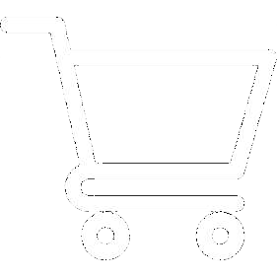

Cybersecurity: Domains
Banking and Finance
Online Retail
Healthcare
Education

Slide 7

Cybersecurity: Benefits
Protects the system against viruses, worms, spyware, and other unwanted programs
Minimizes computer freezing
and crashes
Gives privacy to users
Protects the computer from being hacked
Increases cyber defense

Slide 8

Course Outline
Cybersecurity Fundamentals
Secure Enterprise Architecture and Components
1
2
4
3
Information System Governance and Risk Assessment
Incident Management

Slide 9

Learning Outcomes
By the end of this course, you will be able to:
Analyze the threats and vulnerabilities in information systems and ways to resolve them
Apply business security awareness
Troubleshoot threats using secure enterprise architecture
Create an effective defense in cyber-related attacks and threats

Slide 10



Course Features
Case Studies:
Free Wi-Fi Network in Tel Aviv
RFID Hack
AWS Outage

Slide 11
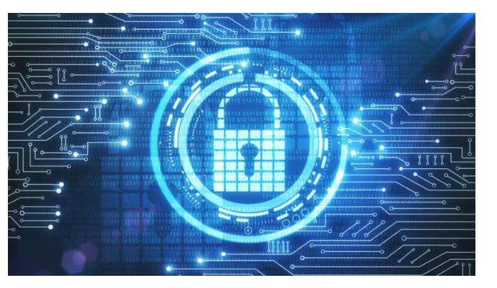
Happy Learning

Slide 13

Cybersecurity Fundamentals

Slide 14


Learning Objectives
By the end of lessons you will be able to:
Explain the fundamentals of cybersecurity Identify threat actors, attacks, and mitigation
Describe security policies, procedures, standards, and
baseline
Elaborate the cybersecurity mitigation methods

Slide 15

Fundamentals of Cybersecurity

Slide 16


What Is Cybersecurity?
A set of technologies used for protecting systems, networks, and programs from digital
attacks, damage, and unauthorized access.
Unauthorized Access
Attack
Address
Threats
Damage

Slide 17
Why Cybersecurity?
Presence of crime
syndicates
Presence of cyber
armies
Increased demand
to protect data
Presence of
financial frauds
Increased rate
of cyber crime
The world relies on technology more than ever before, and as a result digital data creation has surged.

Slide 18

Information Security and Cybersecurity
Information Security
Cybersecurity
Refers to processes and tools designed to
protect sensitive information
Encompasses paper documents and digital
and intellectual property
Is a set of techniques used to protect the integrity
of networks, programs, and data
Is a component of information security

Slide 19

Cyber Crime Statistics
25+ million records
exposed everyday in
2018
300 billion passwords exist worldwide in 2020
Cyber Crime to cost
$6 trillion in 2021
24,000 malicious mobile apps blocked daily
Healthcare:
Ransomware attacks
will quadruple
60% of fraud originates from mobile devices

Slide 20


Factors Affecting Cybersecurity
Technology
Platforms and tools Network connectivity
Level of IT complexity New or emerging security tools Operational support for security
Business Plans
Nature of business
Risk tolerance
Industry trends
Mergers and acquisitions and partnerships
Outsourcing service providers
1
2
3
4
5

Slide 21

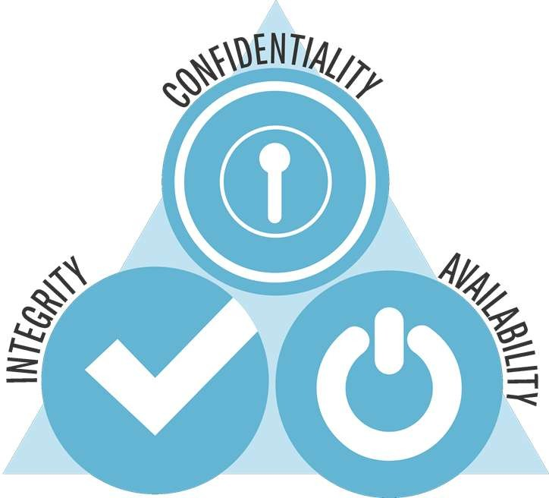
CIA Triad
Information must be available
on demand

Slide 22
CIA Triad
Authorized parties can
access the information

Slide 23
CIA Triad
Authorized people can add,
remove, or alter information

Slide 24
Governance, Risk Management, and Compliance (GRC)

Slide 25





Scope of GRC
Governance, Risk Management, and Compliance of every organization is different and varies based on the type of organization.
It depends on organization mission, size, industry, culture, and legal regulations.
Mission
Regulations
Size
Culture
Industry

Slide 26
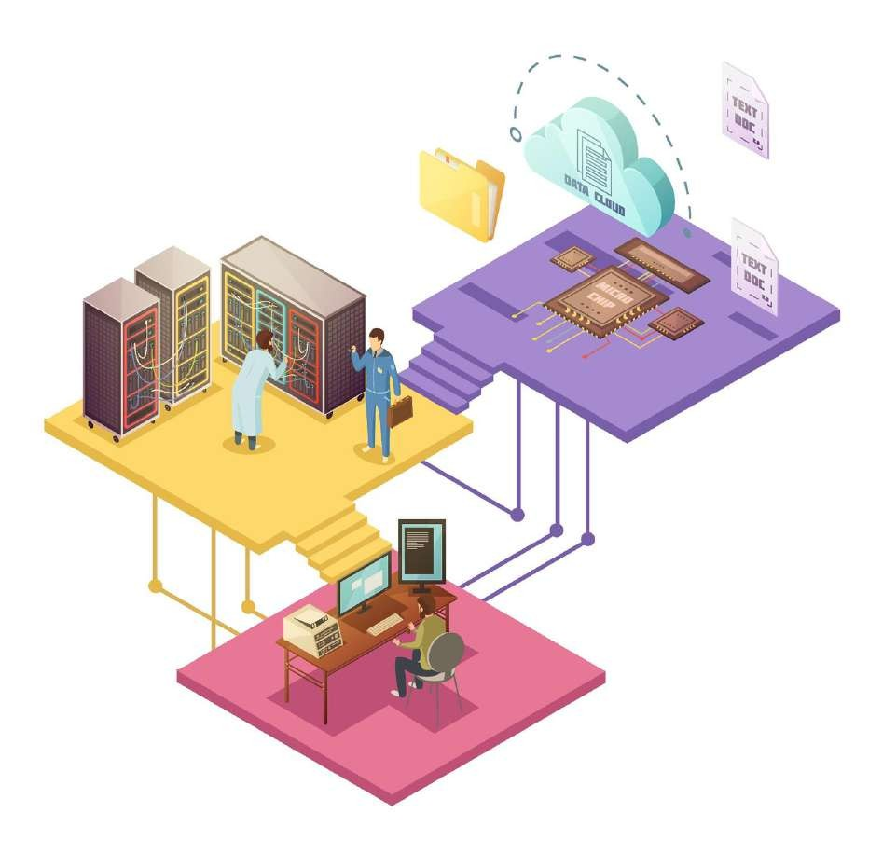
Responsibility of GRC
The ultimate responsibility of the GRC program is to protect their assets and operations IT, including their infrastructure and information.

Slide 27



GRC
The board of directors and senior management of an organization are
responsible for Governance.
Governance
Risk Management Compliance
Provides strategic direction
Ensures that the objectives are achieved
Ascertains whether risk is being managed
appropriately
Verifies that the organization's resources are being
used responsibly

Slide 28
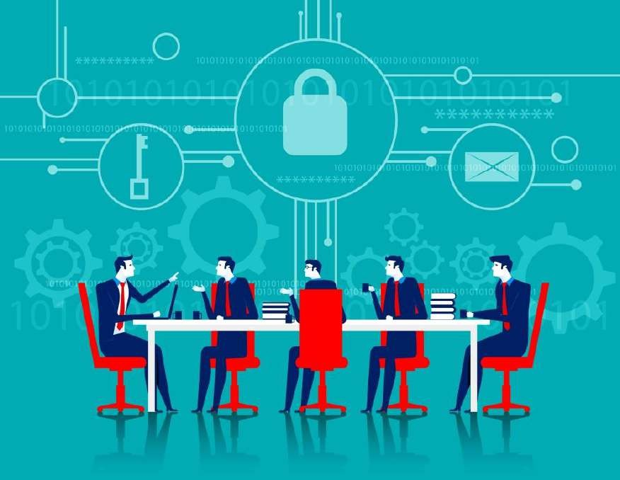
GRC
It is the process by which the organization manages risks to acceptable levels. These risks may include investment risk, physical risk, and cyber risk.
Governance
Risk Management
Compliance

Slide 29
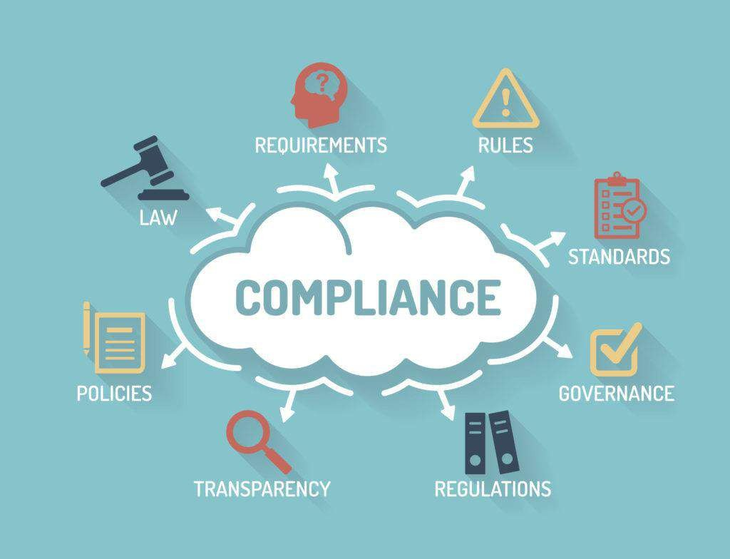
GRC
It is the act of adhering to mandated requirements defined by laws and regulations.
Governance Risk Management
Compliance

Slide 30
Roles of Cybersecurity

Slide 31

Cybersecurity Roles
The success of a cybersecurity role is ultimately the responsibility of the board of directors.
Security Management
Board of Directors
Executive
Committee
Cybersecurity
Practitioners

Slide 32

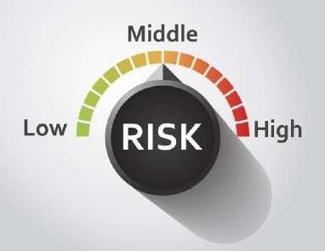

Approaches to Cybersecurity
Compliance-based security
Risk-based security
Ad-hoc approach

Slide 33
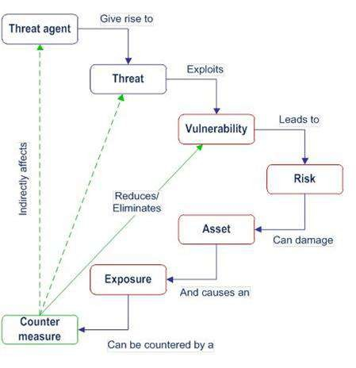
Cybersecurity: Key Terms

Slide 34
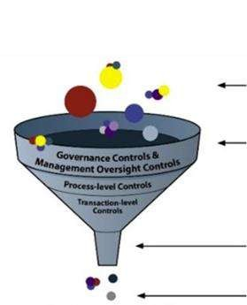
Cybersecurity: Key Terms
Inherent risk
Residual risk

Slide 35






Illustration: Basics of Cybersecurity

Slide 36
Threat Actors, Attacks, and Mitigation

Slide 37
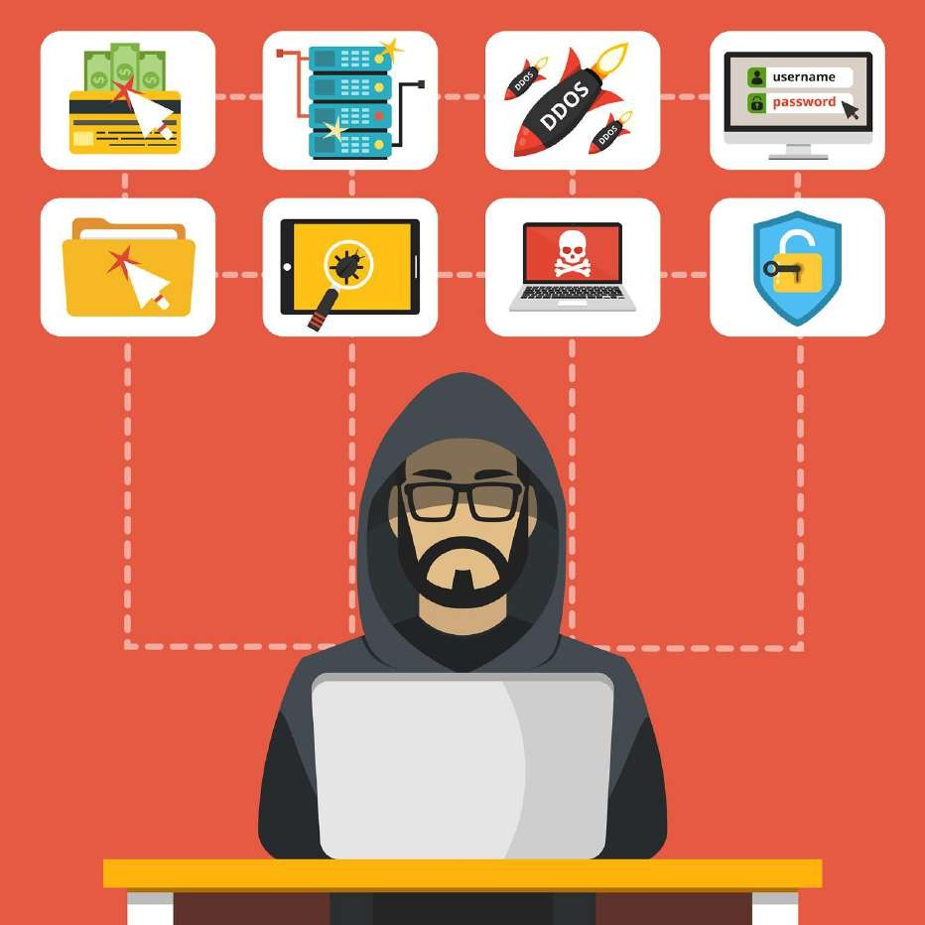
Threat Actor
A threat actor or malicious actor is a person or entity that is responsible for an event or incident that impacts or has the potential to impact the safety or security of another entity.

Slide 38



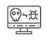


Threat Actor Categories
Script kiddies
Nation states APT
Hactivist
Insiders
Threat Actor categories are:
Organized crime
Competitors

Slide 39

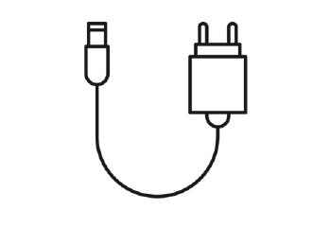


Threats to a System
Main threats to an organization should be considered.
Natural environmental threats
Supply system
threats
Man-made
threats
Sociopolitical
threats

Slide 40

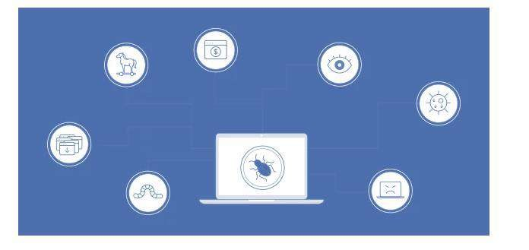
Malware
Malware is any software that is intentionally designed to cause damage to a computer,
server, client, or computer network.

Slide 41
Types of Malware
Worms
Rootkit
Viruses
Backdoor
Trojans
Logic bombs
Spyware
Ransomware
Adware

Slide 42
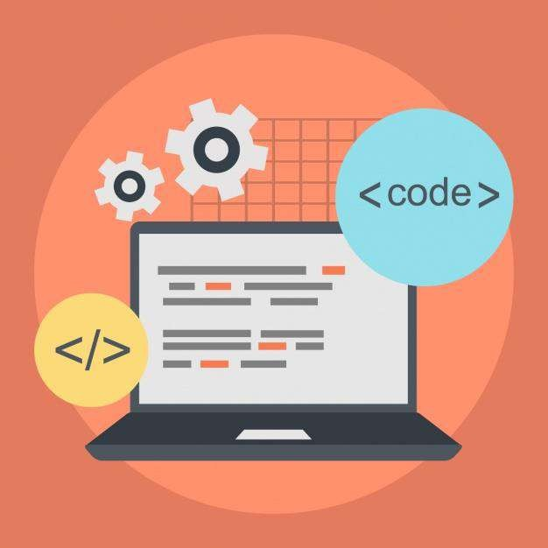
Worms
Worms are self-replicating codes designed to penetrate computer systems.

Slide 43
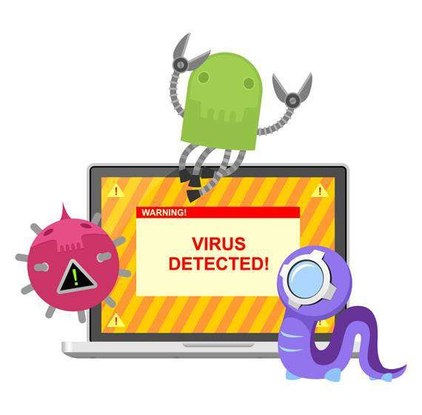
Virus
Virus is a malicious code that replicates by attaching to an executable code.

Slide 44

Trojans
Trojans are programs that claim to perform one function but does another, typically malicious.

Slide 45

Spyware
Spyware is a software aimed to steal personal or organizational information.

Slide 46

Adware
Adware is a software that displays endless ads and pop-up windows.

Slide 47

Rootkit
Rootkits are designed to modify the operating systems’ operations to facilitate non-standard functionality.

Slide 48
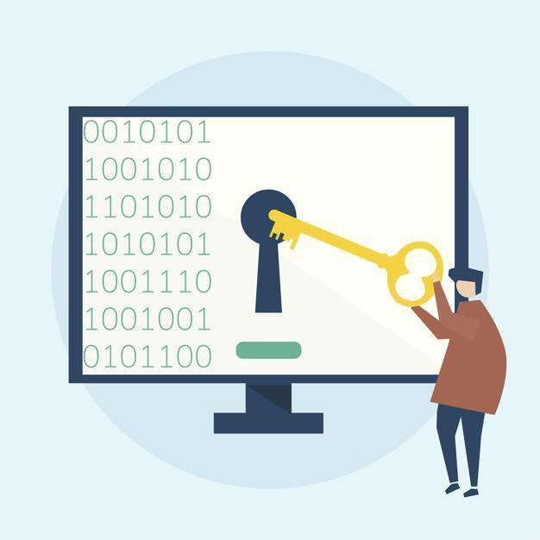
Backdoor
Backdoor provides the attacker with unauthorized remote access to a system by
exploiting security vulnerabilities.

Slide 49
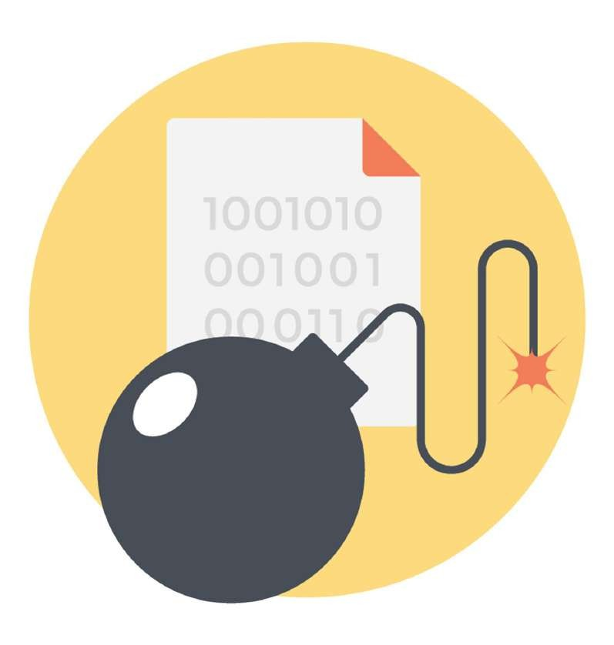
Logic Bombs
Logic bombs infect a system and lie dormant until they are triggered by a specific condition.

Slide 50
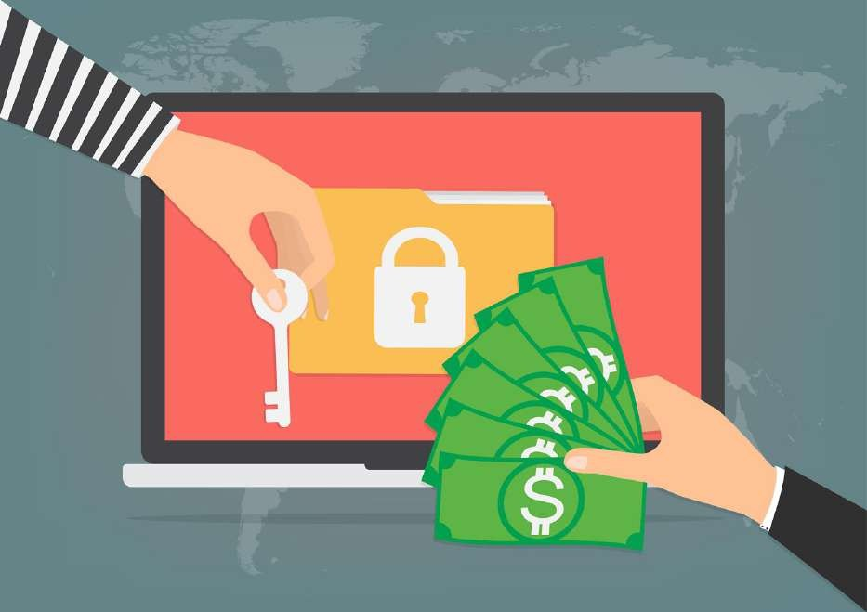
Ransomware
Ransomware attempts to extort money from the user by infecting and taking control of a victim's machine.

Slide 51

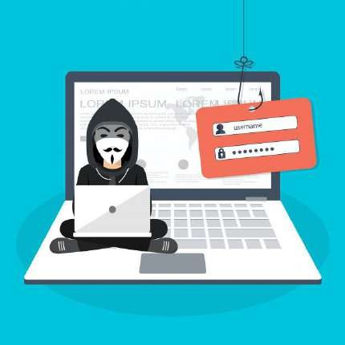
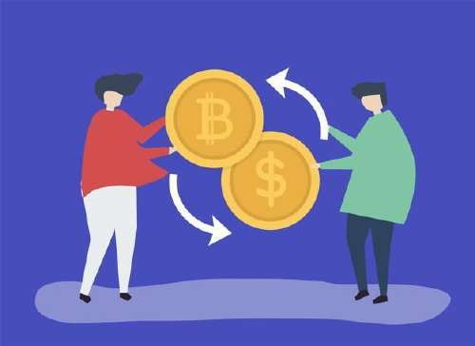
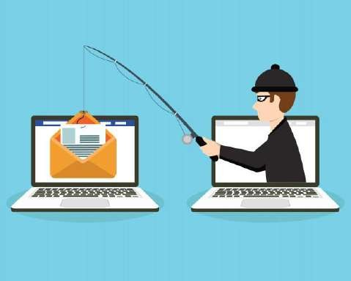
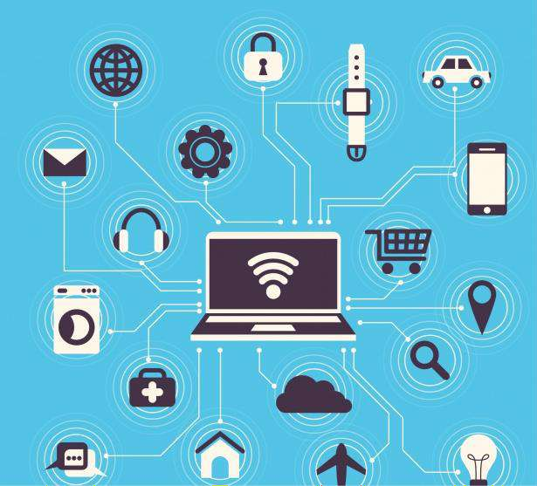
Malware Attacks
Kovter
WannaCry
Zeus or Zbot
Ghost
Mirai

Slide 52
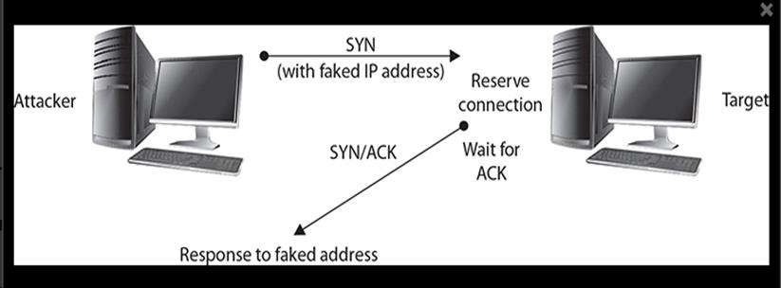
Denial-of-Service Attack
The purpose of DoS is to prevent access to the target system.

Slide 53
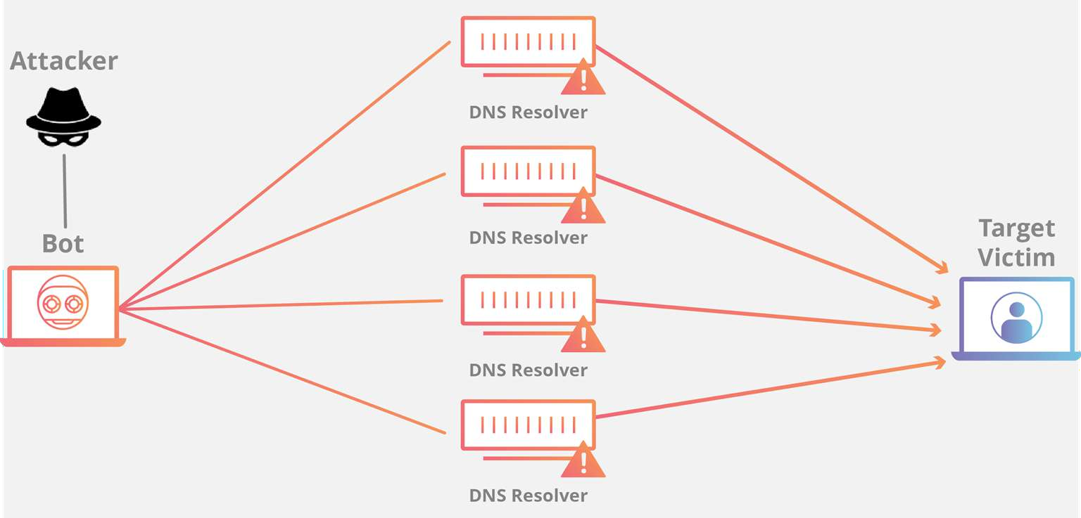
Distributed Denial-of-Service
It is a denial-of-service attack employing multiple attacking systems.

Slide 54
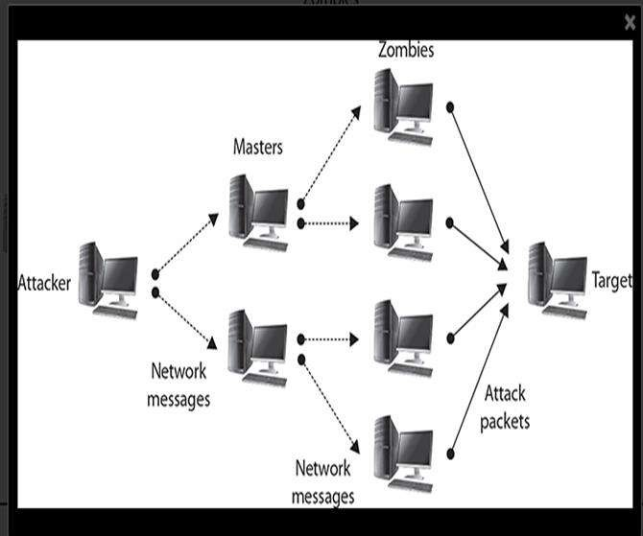
Distributed Denial-of-Service
The goal of DDoS is to prevent access to a specific system.

Slide 55

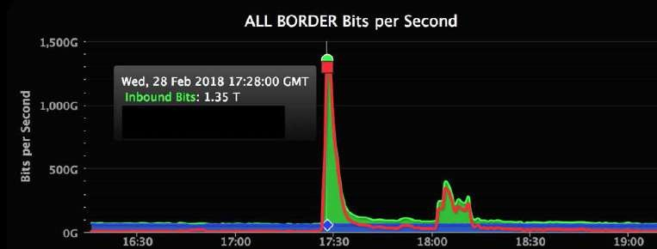
DoS/DDoS Attacks
GitHub: 1.35 Tbps
GitHub was hit with 1.35 terabits per
second of traffic.

Slide 56
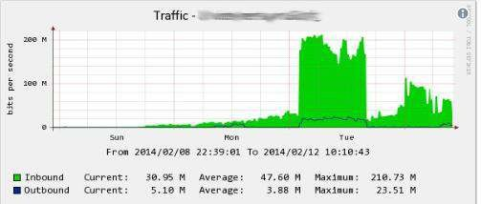
DoS/DDoS Attacks
Cloudflare: 400 Gbps
The attack was directed at a single computer with vulnerability.

Slide 57

Application Layer Attacks
They target computers by causing a fault in the operating system or applications.

Slide 58

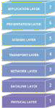
Application Layer Attacks
They refer to a type of malicious behavior designed to target the top layer in the OSI model.

Slide 59
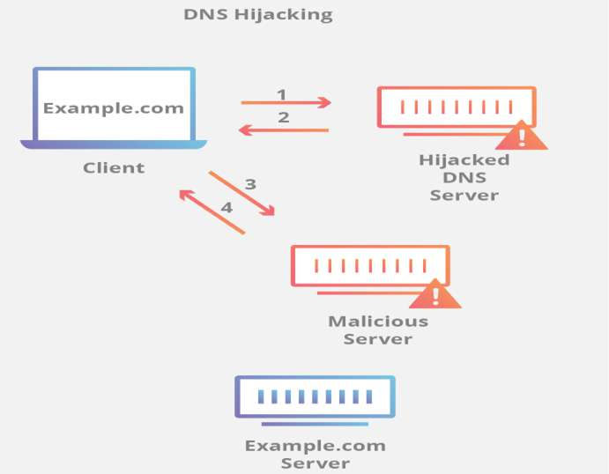
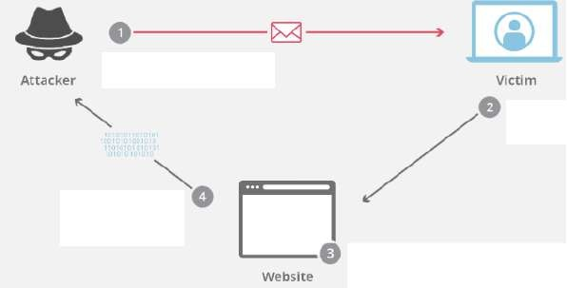
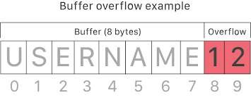
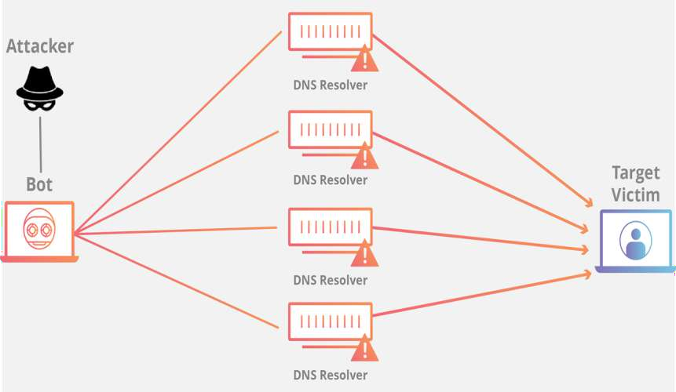
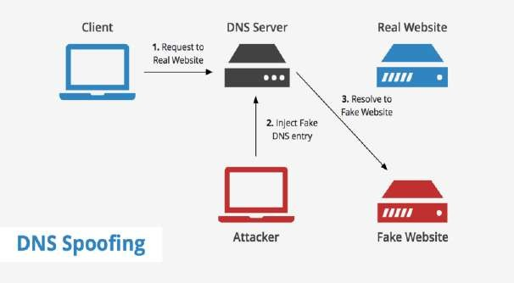
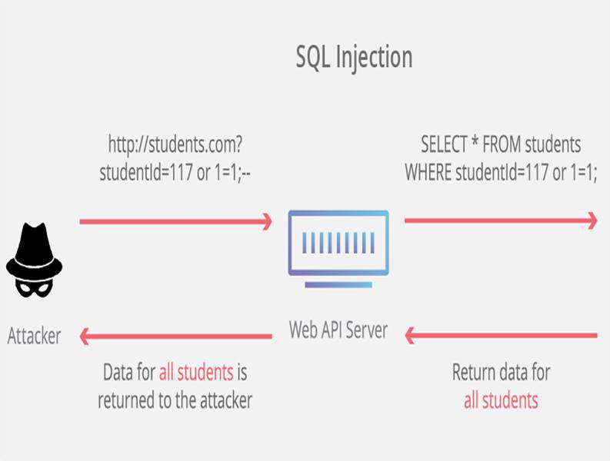
Application Layer Attacks
Cross-site scripting
Buffer overflow
Domain hijacking
DNS spoofing
SQL injection
DoS/DDoS

Slide 60

Software Codes and Security
Programmers are responsible to write safe and high quality codes.

Slide 61
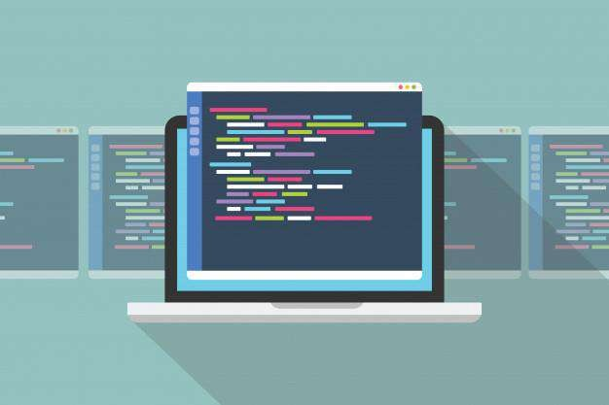
Software Codes and Security
Source codes are statements written using a computer programming language.

Slide 62
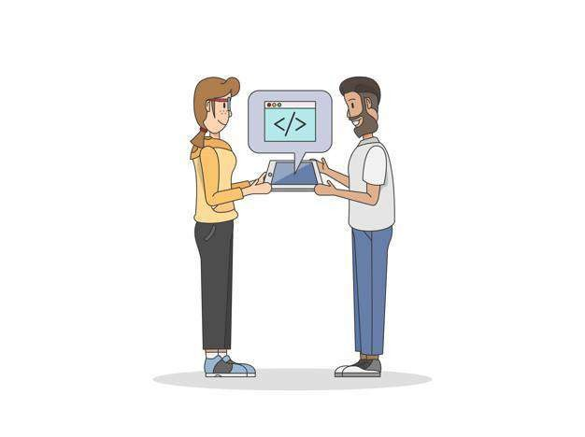


Software Codes and Security
Code review is a systematic examination or peer review of source code.
Find mistakes
Improve software quality

Slide 63
Software Testing Methods
Evaluates the security of software in a runtime environment
Static Testing
Dynamic Testing
Evaluates the security of software without running it

Slide 64


Software Testing Methods
In March 2018, hackers hit Saks Fifth Avenue and Lord & Taylor, stealing debit and credit cards.
5 million records breached

Slide 65

Software Testing Methods
In May 2018, the concert and sporting event ticketing website, ticketfly was vandalized,
taken down, and disrupted for a week.

Slide 66

Security Attacks
In August 2018, Russian hackers made millions selling credit card details stolen from almost 245,000 British Airways customers.

Slide 67
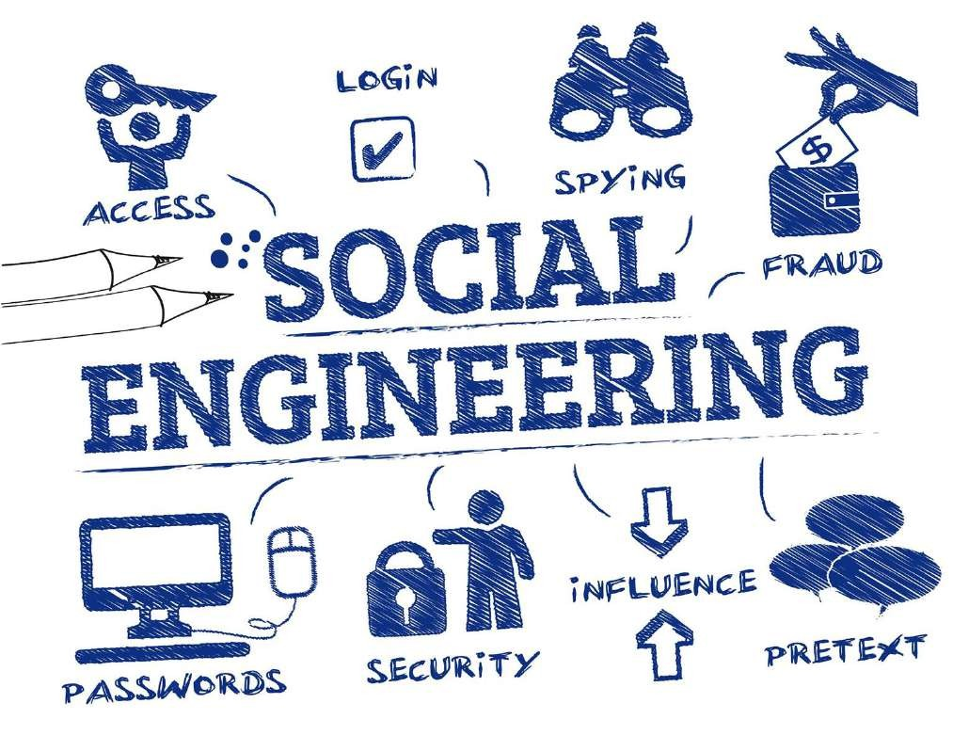
Social Engineering
It is the art of manipulating people, so they give up their confidential information violating the security principle.

Slide 68
Social Engineering Attack Categories
There are several attack categories of social engineering.
Spear Phishing
Phishing
Whaling Phishing

Slide 69
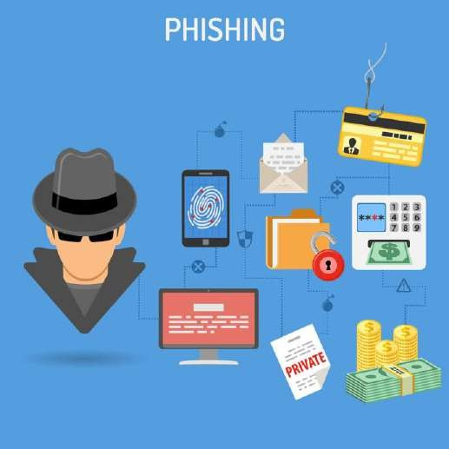
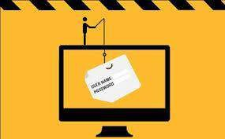

Social Engineering Attack Categories
Phishing
Spear Phishing
Whaling Phishing
It is a fraudulent attempt to obtain sensitive information.
It is targeted to a specific group or an individual.
It targets wealthy and
prominent individuals.

Slide 70

Social Engineering Attack: Ethereum Classic
In 2017, Ethereum Classic website was hacked resulting in the loss of thousands of dollars in
cryptocurrency.

Slide 71

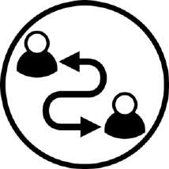


Social Engineering Attack: Ethereum Classic
Impersonated
Ethereum owner
Redirected the domain
to their server
Gained access to domain registry
Extracted cryptocurrency
from the victims

Slide 72
Security Policies and Procedures

Slide 73
Security Management Plan
Initiates and defines
policies
Senior Management
Releases standards and policy guidelines
Middle Management
Operations Management/IT Team
Implements the controls
and policies
End Users
Must comply with the
organization’s functions

Slide 74

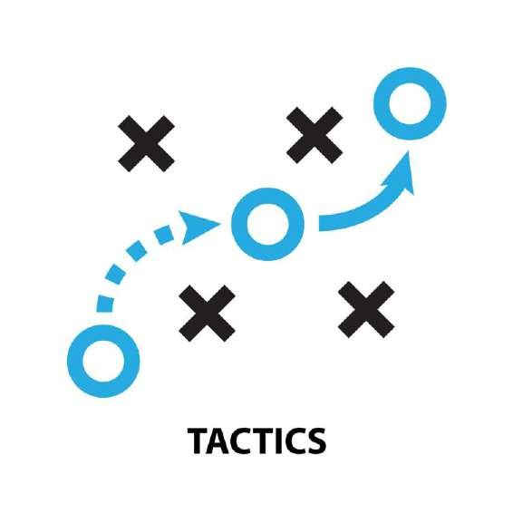

Types of Security Management Plan
Strategic Plan
Tactical Plan
Operational Plan

Slide 75



Types of Security Management Plan
Strategic Plan
Tactical Plan
Operational Plan
Is a long-term plan
Defines security posture
Is valid for five years and is
renewed annually
Helps understand security
functions
Helps in risk assessment

Slide 76


Types of Security Management Plan
Strategic Plan
Tactical Plan
Operational Plan
Is a mid-term plan
Provides detailed goals
Is updated every year or two
Is technology oriented

Slide 77


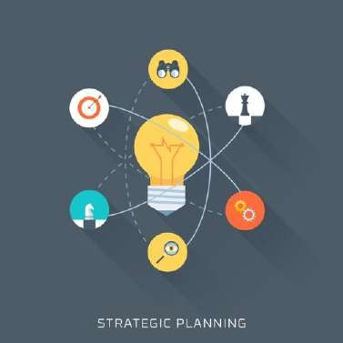
Types of Security Management Plan
Strategic Plan
Tactical Plan
Operational Plan
Is a short-term plan
Is highly detailed
Is updated monthly or
quarterly
Spells out how to accomplish
goals

Slide 78
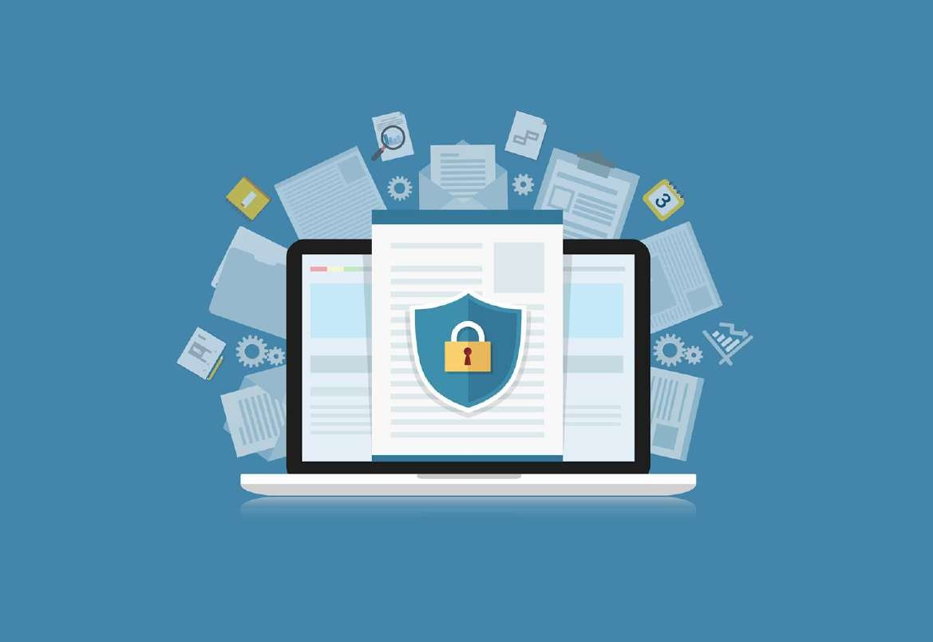
Security Policy
Is a strategic plan
Defines the scope of security
Outlines security objectives
and framework
Identifies the functional areas
Outlines security goals and
practices
Assigns responsibilities and requirements
Defines risk levels

Slide 79
Types of Security Policy
Focuses on issues relevant to every aspect of the organization
Organizational
policy
Issue-specific
policy
System-specific
policy
Focuses on a specific service, department, or function
Focuses on individual
systems

Slide 80

Security Policy Framework
Standard
Procedure
Guideline
Defines the minimum level of
security
Is system specific
Establishes the common
secure state
Baseline

Slide 81
Security Policy Framework
Standard
Procedure
Offers recommendations on
implementation
Serves as an operating guide
Is customized for each unique system
Guideline
Baseline

Slide 82
Security Policy Framework
Standard
Is the final element of formalized
security policy structure
Describes actions for implementing
the security mandates
Is system and software specific
Ensures integrity of the business
process
Procedure
Guideline
Baseline

Slide 83
Security Policy Framework
Defines the compulsory requirements
Provides a course of action
Is a tactical document
Standard
Procedure
Guideline
Baseline

Slide 84
Due Care and Due Diligence
Due Care
Due Diligence
Reasonable care is taken in
protecting the organization
Pertains to the legal duty of the
organization
Lack of due care is considered
negligence
Is about practicing the activities that maintain the due care effort
Pertains to best practices that a company should follow
Might not be legally liable

Slide 85
Cybersecurity Mitigation Methods

Slide 86
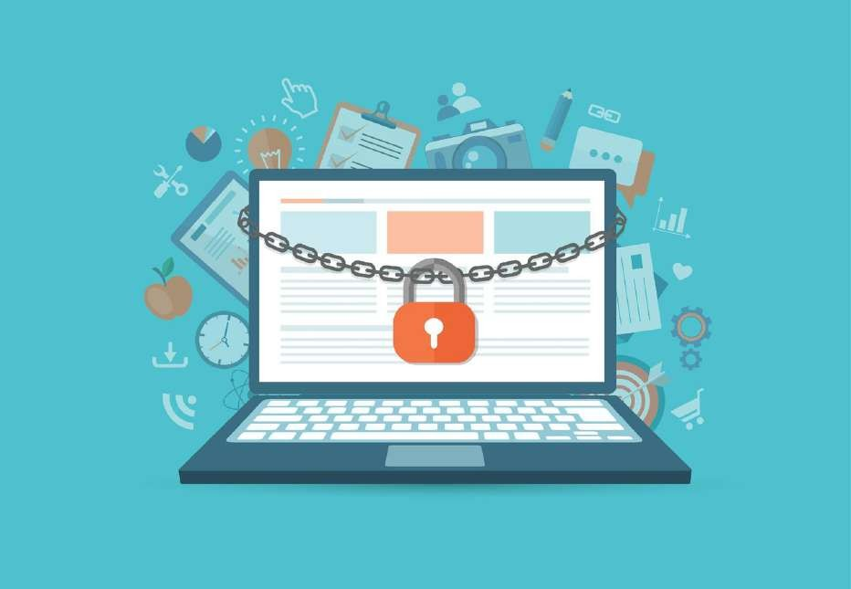
Information Technology Control
An IT control is a procedure or policy that provides a reasonable assurance that:
IT used by an organization is
operating as intended
The organization is in compliance with laws and regulations
Data is reliable

Slide 87

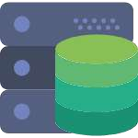


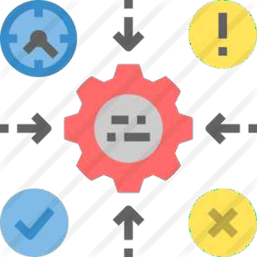
Countermeasure
It is an action or method that is applied to prevent, avert, or reduce potential threats to:
Computers
Networks
Servers
Operating systems
Information systems

Slide 88



Countermeasure
It helps to mitigate or reduce the potential risk.

Slide 89

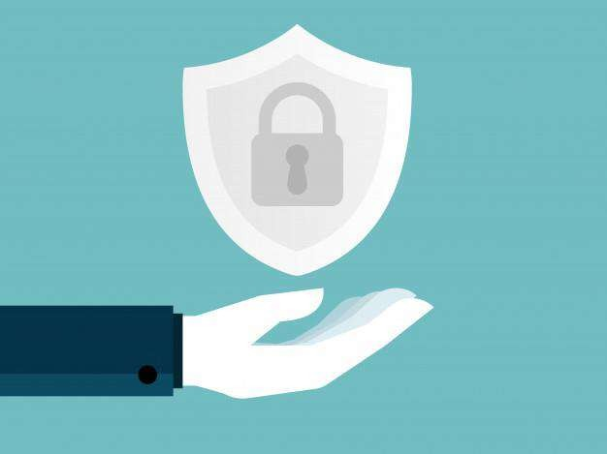
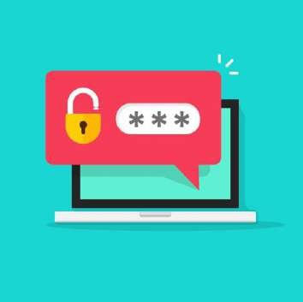
Control Categories
Administrative controls
Technical controls
Physical controls

Slide 90
Administrative Controls
These are procedures and policies used to define employee actions toward sensitive information.

Slide 91




Technical Controls
These are hardware or software mechanisms used to protect important and
confidential assets.

Slide 92



Physical Controls
These are security measures designed to deny unauthorized access.

Slide 93






Physical Controls
Detective
Deterrent
Corrective
Preventive
Recovery
Compensating

Slide 94

Defense in Depth or Layered Approach
It is the act of using multiple layers of security controls to protect the integrity of information.

Slide 95
Defense in Depth or Layered Approach
Its intent is to provide increased security through intentional redundancy based on multi-layered security approach.
Personnel
Procedural
Technical
Physical

Slide 96

Defense in Depth or Layered Approach

Slide 97

Identity Management
It is an organizational process for identifying, authenticating, and authorizing individuals or
groups of people.
Identified
Authenticated
Authorized

Slide 98

Identity Management
It enables the right users to access the right resources at the right time for the right reasons.

Slide 99
IAM Components
Authentication
Authorization
The components of
IAM are:
User Management
Central user repository

Slide 100


Identification and Authentication
Identification
Authentication
Identify a user or an application in
the system
Prove that a user or an application
is genuine

Slide 101



Identification and Authentication
Something you know
Something you have
Password
Token card
Something you are or do
Where you are
Biometric
Location

Slide 102

Multi-Factor Authentication
It is an authentication method where a user is granted access after
presenting two or more evidences.

Slide 103


Two-Factor Authentication
It is a subset of multi-factor authentication, confirming that users are
granted access with a combination of two different factors.

Slide 104
Multi-Factor Authentication
It is an authentication method where a user is granted access after
presenting two or more evidences.

Slide 105

Authorization
It is the process of determining what types of activities, resources, or
services a user is permitted.

Slide 106



Authorization
A user may be authorized for different types of activity once authenticated.

Slide 107



Accountability
It is the traceability of actions performed on a system to a specific system entity.

Slide 108


Accountability
User identification and authentication
support accountability
User ID and password destroy
accountability

Slide 109


Auditing
It is a manual or a systematic measurable technical assessment of a system or application.
Reviewing applications and OS access controls
Interviewing staff
Analyzing physical access to the systems
Performing security
vulnerability scans

Slide 110

Monitoring
It is a manual or a systematic measurable technical assessment of a system or application.
Defining the behavior types
to trigger alerts
Taking actions on alerts
as needed

Slide 111

Patch Management
It involves acquiring, testing, and installing multiple patches to an administered computer system.

Slide 112





Patch Management Tasks
Maintain knowledge of available patches
Decide appropriate patches
for particular systems
Ensure that patches are installed properly
Test systems after installation
Document all associated procedures

Slide 113

Patch Management: Example
The outbreak of WannaCry ransomware became large and intense
because of a missing security patch.

Slide 114

System Hardening
It is a collection of tools, techniques, and best practices to reduce vulnerability.
Technology applications
Systems
Infrastructure
Firmware

Slide 115

System Hardening: Purpose
It eliminates security risks and secures a system by reducing its attack surface.

Slide 116

System Hardening Activities
Use encryption
Update security patches and hotfixes
on time
Remove unnecessary programs and user accounts
Hardening activities for a computer system includes:
Monitor security
bulletins
Create strong
passwords
Install anti-virus and spyware protection system
Close certain ports
Deny file sharing

Slide 117

Change Control
It is a systematic approach to manage all changes made to a product or system.

Slide 118

Change Control: Purpose
All changes are
documented
No unnecessary
changes are made
Services are not disrupted
Resources are used
efficiently

Slide 119

Change Control: Purpose
Formal RFC
Implementation
Possible
rollback
Change
request
Change approval
board
Review

Slide 120

Asset Management
It is the systematic process of developing, operating, maintaining, upgrading,
and disposing of assets cost-effectively.

Slide 121
Asset Management Lifecycle
Procurement
1
2
Deploy and discover
Retirement and disposal
5
3
Maintain
4
Support

Slide 122




Data Management
Data is the smallest piece of information in any form.
Text documents
Images
Audio clips
Software programs

Slide 123

Data Management
It is an administrative process to ensure the accessibility, reliability, and timeliness of the data for its users.
Storing data
Protecting data
Validating data
Acquiring data
Processing
data

Slide 124

States of Data
They describe the different modes whereby data is used by a computing equipment.

Slide 125



Three Basic States of Data
Data at rest
Data in transit
Data in use

Slide 126




Information Lifecycle
Acquisition: Indexed system data
Disposal: Stored data for
destruction
Archival: Backup, protection, and retention
Use: Challenges in
protection

Slide 127

Information Lifecycle
It is an ongoing
process
It helps ensure data is protected
Metadata must be at the
right classification level
It helps indicate the level of data protection
Classification level must be attached
to the information lifecycle

Slide 128

Encryption
It describes the different modes whereby data is used by a computing equipment.

Slide 129

Encryption

Slide 130

Encryption
Protects data in transit over
networks
Protects information stored
on computers
Deters and detects alterations of data
Verifies the authenticity of a transaction

Slide 131

Cryptography
Cryptography is the science of protecting information by encoding it into an unreadable format.

Slide 132

Cryptography

Slide 133
Factors Influencing Effective Encryption
The non-existence of back doors
Algorithm strength, secrecy, and difficulty of compromising a key
The inability to decrypt an entire cipher text

Slide 134


Types of Encryption
Symmetric Encryption
Asymmetric Encryption

Slide 135



Symmetric Encryption
Symmetric encryption is based on the same key or private key to encrypt plain text and decrypt ciphertext.
Uses one key to encrypt and decrypt
Uses less processing power
Shares the key with the
receiver

Slide 136


Symmetric Encryption
Common private key cryptography systems:
Data Encryption Standard (DES)
Advanced Encryption Standard (AES)
64-bit
128-bit to 256-bit

Slide 137

Asymmetric Encryption
Solves the problem of sharing the key with the receiver

Slide 138



Asymmetric Encryption
Services of cryptography:
Authentication
Non-repudiation
Confidentiality
Validates the
sender’s identity
Prevents denial
of action
Controls who reads
the data

Slide 139

Incident Response
It is an organized approach to address and manage the aftermath of a security breach.

Slide 140

Incident Response: Goals
Reduces damage, recovery
time, and costs
Manages potential
disruption to IT service
Has normal service
operations within SLAs
Minimizes the adverse impact on business operations

Slide 141

Security Training
It is an organized approach to addressing and managing the aftermath of a security breach
or cyber attack.

Slide 142

Security Awareness
It is the process of exposing people to security issues so that they may be able to recognize them and better respond to them.

Slide 143
Key Takeaways
Cybersecurity refers to a set of techniques used to protect the integrity of network programs and data from attack, damage, and unauthorized access.
Malware is a software that is designed to cause damage to a computer, server, client, or network. The types of malware include worm, spyware, virus, trojan, and logic bomb.
Strategic plan, tactical plan, and operational plan are the types of
security management plans.
Change control is a systematic approach for managing all
changes made to a product or system.

Slide 145
Secure Enterprise Architecture and Component

Slide 146


Learning Objectives
By the end of this lesson, you will be able to:
Describe network architecture Explain wireless networks
List the network security controls
Explain security testing

Slide 147
Network Architecture

Slide 148

Enterprise Network Architecture
Networks are part of a large, centrally managed, and internetworked architecture solutions.

Slide 149



Enterprise Network Architecture
Web-based front-end application servers
Application and database servers
Mainframe servers

Slide 150


Enterprise Network Architecture
Organizations implement service-oriented architectures (SOA) with web software components.
Simple Object Access Protocol (SOAP)
Extensible Markup Language (XML)

Slide 151


Basics of Network Architecture
Telecommunications:
Electromagnetic transmission of
data
Protocol:
A standard set of rules

Slide 152



Types of Network Architecture
Open Network Architecture
Closed Network Architecture
Not Proprietary
Proprietary
Integrates vendor implementations
Not integrated with vendors

Slide 153
Open System Interconnection (OSI) Model

Slide 154

Open System Interconnection (OSI) Model
OSI is a layered architecture.
Simplifies the network design
Helps in easier network management
Helps in debugging network
applications

Slide 155

Seven Layers of OSI Model
Presentation
2
3
Session
Application
1
4
Transport
Physical
7
5 Network
6
Data Link

Slide 156
Types of Networks

Slide 157
Types of Networks
Wide Area Network
(WAN)
Metropolitan Area
Network (MAN)
Local Area Network (LAN)
Storage Area Network (SAN)
Personal Area Network (PAN)
The types of networks are:

Slide 158
Data Communication Systems

Slide 159

Data Communication Systems
A process of using computing technology to transfer data from one point to another.
Data Communication Systems: Transfers digital data between nodes
Uses ASCII, EBCDIC, and Unicode for conversion

Slide 160



Data Communication Software Components
Information to be communicated
The components of communication software are:
Sender and receiver
Medium or channel

Slide 161
Computer-Based and Business Information Systems

Slide 162
Computer-Based Information System
Procedures
Hardware
People
The computer- based information system are:
Software applications
Internet
Database
Networks
Telecommunications

Slide 163

Business Information Systems
Decision Support System
SOA Systems
Transaction Processing
Electronic Commerce
Management Information System

Slide 164
Hardware Failure

Slide 165

Hardware Failure
It is a malfunction within the electronic circuits or electromechanical components

Slide 166




Hardware Failure
Encryption
Physical Security
Media Sanitization
Maintenance

Slide 167




Hardware Failure
Exposed Data
Lost
Hardware
Virus
Spyware
Data Loss
Malicious Code
Physical Theft
Data Corruption
Storage
Media
Computers
Damaged
Drive
Corrupted Drive

Slide 168
Hardware Failure
Asset management reports
Error reports
Availability reports
Utilization reports (automated)
Check
List the
Detect failures and provide corrective actions
downtime caused by inadequate facilities and excessive maintenance
Document the utilization of machine and peripherals
network inventory tools and their connected equipment

Slide 169
Host-Based Security

Slide 170

Host-Based Security
Host security refers to securing the operating system from unauthorized access.

Slide 171






Host-Based Security Controls
Host-Based Firewalls
Intrusion Detection System
Antivirus
Disk Encryption
Regular Backups
Access Control

Slide 172
Wireless Networks and Virtual Private Network

Slide 173

Wireless Networks
Wireless networks are computer networks that are not connected by cables of any kind.

Slide 174
Wireless Networks
Benefit:
Drawback:
Mobility
Speed
Network Reach
Security
Flexibility/Scalability

Slide 175


Wireless Attacks
Pose challenges to
security professionals
Easy setup at the cost of security

Slide 176



Wireless Countermeasures
Use encryption
Use Antivirus
Use WPA3
authentication
Turn off SSID
Change the
password

Slide 177

Case Study: Wireless Attack
Tel Aviv free Wi-Fi network was hacked. One notable example of how easy it can be
for a hacker to take over a Wi-Fi network comes from Tel Aviv.

Slide 178

Case Study: Wireless Attack
The free Wi-Fi network of Tel Aviv was hacked.
It incorporates basic security controls to keep users secure in the network.

Slide 179


Case Study: Wireless Attack
Noticed a new Wi-Fi access point
Tested its security controls
Discovered an HTTPS port 443

Slide 180

Virtual Private Network
VPN extends the corporate network securely via encrypted packets sent out via virtual connections over the public internet to distant offices, home workers, salespeople, and business partners.

Slide 181




Virtual Private Network
Accesses their
corporate enterprise
Communicates with business partners
Increases the network span
Helps in being efficient
and effective
Helps grow their
business

Slide 182

Types of Virtual Private Network
Intranet VPN
Remote access VPN
Extranet VPN

Slide 183





Virtual Private Network
Lack of required host security software
Physical access
Endpoints
Man-in-the-middle attacks
Hardware limitations

Slide 184



VPN Risks
Strong user authentication
Host identity verification
Security posture validation
Secure desktop
Configuration considerations
Education and awareness

Slide 185
Wireless Network Example: Bluetooth
Speed is 2.4 GHZ and range is between 10 to 30m
Introduced in 1994
Uses radio waves for communication
Short-range wireless communications technology

Slide 186

Bluetooth Attack Example
Bluejacking is the unauthorized sending of text messages to a nearby Bluetooth device.

Slide 187



Bluetooth Countermeasures
Use Bluetooth for confidential information
Change the default PINs on your devices
Do not leave your devices in discovery mode
Turn off Bluetooth when it’s not in active use

Slide 188


Bluetooth Vulnerability: BlueBorne
It is a set of nine exploitable Bluetooth vulnerabilities.
It affects every laptop and
mobile device.
The airborne attack is difficult to protect.

Slide 189
Radio-Frequency Identification (RFID)

Slide 190

Radio-Frequency Identification (RFID)
RFID uses radio waves to read and capture information stored on a tag attached to an object.

Slide 191
RFID Risks
Business Process Risk
Business Intelligence Risk
Externality Risk
Privacy Risk

Slide 192



RFID Security Controls
Management
Operational
Technical

Slide 193



Case Study: RFID Hack
Mobile Keys and Bluetooth
Uses near-field communication (NFC)
Guests download an app to their phones
Opens the door with signals

Slide 194

Emanation Security
It is a hardware or electronic device that emits electromagnetic radiation.

Slide 195


Controls Against Electronics
Faraday Cage
White Noise
Control Zones

Slide 196
Network Security Controls

Slide 197
Network-Based Security
Hacking, viruses, and
spyware
Denial of service
Email spoofing
Trojan Horses
Unauthorized
access
Prevents computer network from:

Slide 198


Network Attack Categories
Active attack
An intruder initiates commands to disrupt the network's normal operation.
Passive attack
An intruder intercepts data traveling through the network.

Slide 199

Firewall
Stops hackers from accessing network
Controls network
traffic
Allows users to access the internet

Slide 200

Firewall Features
Controls the vulnerable point between a corporate network and the internet
Is a combination of hardware and
software

Slide 201

Unified Threat Management (UTM)
UTM combines several key elements of network security to offer a comprehensive security package to buyers.

Slide 202


Unified Threat Management (UTM)
Goals
Issues
Simplicity
Streamlined installation and maintenance
Centralized control
Single point of failure
Single point of compromise
Performance issues

Slide 203

Web Application Firewall
Filters, monitors, and blocks
HTTP traffic
Filters the content of specific
web applications
Prevents attacks from web
application security flaws

Slide 204

Intrusion Detection System (IDS)
Intrusion Detection System otherwise known as IDS is monitored network usage anomaly.
Works together with firewalls and routers
Operates in the background
Alerts when intrusions are detected
Protects external and internal misuse

Slide 205




Intrusion Detection System Components
Sensor
User Interface
Analyzer
Admin Console

Slide 206


Intrusion Detection System Categories
Network-based IDS (NIDS)
An intruder initiates commands to disrupt the network's normal operation.
Host-based IDS (HIDS)
An intruder intercepts data traveling through the network.

Slide 207

Intrusion Prevention System (IPS)
Closely related to IDS
Designed to detect and prevent attacks
Must be properly configured and tuned to be effective

Slide 208

Network Admission Control
It is a concept of controlling access to an environment through strict adherence and implementation of security policy.

Slide 209



Network Admission Control Goals
Prevent/reduce zero-day attacks
Enforce security policy throughout the network
Use identities to perform
access control

Slide 210

Honeypots
A honeypot system is a computer that sits in the screened subnet or the DMZ and attempts to lure attackers.
Have services emulated
Enable services and ports

Slide 211

Honeypots
Group of honeypots implemented together is called a honeynet.

Slide 212
Security Testing

Slide 213

Vulnerability Scanning
It is a process of examining your systems and network devices for security holes and weaknesses.

Slide 214

Vulnerability Scanning
Vulnerability scanners are designed to help administrators and address vulnerabilities.

Slide 215

Vulnerability Scan Goals
Identify vulnerability
Identify lack of security controls
Identify common misconfigurations
Some scanners are capable of remediation checking for misconfigurations.

Slide 216

Penetration Testing
Tries to exploit the system
The most aggressive form of
security testing
Uncovers any weaknesses within the environment
Simulates an attack from a malicious outsider.
Emulates the same methods attackers would use

Slide 217

Types of Penetration Testing
The types depend on the organization, its security objectives, and the management goals.

Slide 218

Types of Penetration Testing
In black box testing, the tester has no knowledge of the internal design or features of the
system. It simulates the external attacker the best.

Slide 219

Types of Penetration Testing
In white box testing, the tester has complete knowledge of the internal system, it may yield a more complete result, but it may not be representative of an external hacker. It may be a good indicator of an internal type of threat.

Slide 220
Types of Penetration Testing
In grey box testing, some information about internal working is given to the tester.
Helps guide tester tactics
Mitigates the risks

Slide 221
Security Audits

Slide 222

Security Audits
These are systematic evaluations performed with the purpose of demonstrating the effectiveness of controls to a third party.

Slide 223

Security Audits
It is performed by independent auditors. Auditors provide unbiased view of the state of security controls.

Slide 224


Types of Security Audits
It is performed by an organization’s internal staff.
The reports are intended for internal audience.
It is performed by third-party auditors.
The reports are intended for third-party stakeholders.
NDA is a prerequisite.
Disadvantage: Conflict of interest and hidden agenda
Disadvantage: Cost

Slide 225
Key Takeaways
Networks are part of a large, centrally managed, internetworked
architecture solutions.
Wireless networks are computer networks that are not
connected by cables of any kind.
Network-based protection or security is a method of preventing your computer network from unauthorized user access.
Security testing is a process of examining your systems and
network devices for security holes and weaknesses.

Slide 227
Information Security Governance and Risk Assessment

Slide 228
Learning Objectives
By the end of this lesson, you will be able to:
Explain information security governance Describe risk management
Summarize effective information security program
Define supply chain

Slide 229
Information Security Governance

Slide 230




Information Security Governance
It is a set of responsibilities and practices exercised by the board and executive management to:
Achieve goals
Manage risks
Meet objectives
Verify usage of resources

Slide 231
IT Governance Focus Areas
Performance
Measures
Strategic Alignment
Resource Management
Value Delivery
Risk Management
IT Governance

Slide 232




Business Goals and Objectives
Strategic Plan
Tactical Plan
Operational Plan
To meet customer needs by ensuring that business processes and operations are in place

Slide 233





Business Drivers
Market demands
Legal requirement
Organizational needs and brand image
Social needs
Business Drivers
Customer requests
Technological advancement

Slide 234

Enabling Technology
It is an invention or innovation that can be applied to drive radical change in the
capabilities of a user or culture.

Slide 235

Enablers for Governance
Enablers are factors that individually and collectively influence whether something will work.

Slide 236





Enabler Categories
Principles, Policies,
and Frameworks
Services, Infrastructure, and Applications
People, Skills, and Competencies
Processes
Culture, Ethics, and Behavior

Slide 237

Information Security Governance
Is the responsibility of the board of directors and executive management and must have a clear organizational strategy for preservation

Slide 238

Information Security Governance: Outcomes
Information security is treated as a critical business issue
Clear approval and support for formal security strategies
Professionalism demonstrated to third parties
The outcomes of information security governance are:
Performance in implementing security policies is monitored
Information security effectiveness is reviewed periodically
Security awareness and training is provided
High level of oversight and control
Implementation and maintenance of information security activities

Slide 239
Management Support

Slide 240

Management Support
It is the extent to which the senior management understands the importance of the security function
and supports security goals and priorities.

Slide 241




Management Support
Participating in security plans and policies
Committing funding and resources
Providing overall guidance
Identifying key performance metrics

Slide 242
Establish Reporting and Communication Channels
Senior management
Other management
The user needs to have routine communication channels to:
Business process owners
Employees

Slide 243
Performance Management and Smart Metric

Slide 244
Performance Management
It is the systematic process by which the Department of Commerce involves its employees as
individuals and members of a group.
IT balanced scorecard
Capability maturity model
Types of Performance management

Slide 245

IT Balanced Scorecard
It is a performance metric used in strategic management to identify and improve various internal
functions of a business.

Slide 246

Capability Maturity Model
It is a methodology used to develop and refine an organization's software development process.

Slide 247

SMART Metric
A smart metric stands for specific, measurable, achievable or acceptable, realistic, and time specific or trackable.
Achievable
Measurable
Realistic
Specific
Time based

Slide 248
Risk Management

Slide 249

Risk Management
It is the process of identifying, assessing, monitoring, and controlling events arising from risks.

Slide 250

Risk Management
Risk cannot be removed but it can be minimized to an acceptable level.

Slide 251






Risk Management Process
Analyze: Assess the risk
Identify: Identify the risk
Action: Develop a risk
management plan
Control: Reevaluate the risk
Monitor: Implement risk management actions

Slide 252

Quantitative Risk Analysis
It is a technique used to assess the effect of risk exposure events on overall organizational objectives.

Slide 253
Quantitative Risk Analysis
Enables business to prioritize risks
Assists in measuring the magnitude of impact
Calculates absolute financial values

Slide 254






Quantitative Risk Analysis
Provides initial assessment to
identify risks
Considers organization culture, reputation, and brand image
Is based on expert judgment, intuition, and experience
Uses different risk scenarios
and ranks threats
Ranks risks based on severity

Slide 255



Risk Management Methods
Risk Mitigation: Implement measures to eliminate vulnerabilities
Risk Transfer: Transfer the risks to another entity
Risk Management methods are:
Risk avoidance: Eliminate activities that involve risks
Risk acceptance: Make decisions to live with the risks

Slide 256
Key Risk Indicator and Key Performance Indicator
Key Performance Indicator is a quantifiable metric that reflects how well an organization is achieving its stated goals and objectives.
Key Risk Indicators are metrics used by organizations to provide an early signal of
increasing risk exposure in various areas of the enterprise.
Metrics
Measurement
KPIs
KRIs
Performance Assessment
Risk Assessment
Analytics
Decision Making

Slide 257

Key Performance Indicator
Provides a high-level overview of the past performance
Measures the performance of security controls

Slide 258


Key Risk Indicator
Serves as an early
warning indicator
Is selected for its impact on
the senior leaders’ decisions

Slide 259
Risk IT Framework
It is a framework based on a set of guiding principles featuring business processes and management guidelines.
A structured process to identify potential organization threats
A strategy for minimizing
the impact of risks
A mechanism to effectively evaluate strategies

Slide 260
Risk IT Framework
Risk IT
Val IT
Risk
Management
Identify Risk and Opportunity
Value
Management
Complements COBIT
Helps implement IT governance
IT-related Events
IT Process Management
COBIT

Slide 261
Risk IT Framework
Risk Evaluation
Analyze risk
Collect data
Maintain risk profile
Risk Response
Manage risks
Articulate risks
React to events
Business Objectives
Risk Governance
Define IT structure, roles, and
responsibilities
Establish and maintain a common risk view
Make risk-aware business decisions

Slide 262
Information Security Programs

Slide 263


Information System (IS) Programs
Ensures that an organization’s information assets are protected
Describes a complete organizational structure
Information System Program

Slide 264

IS Programs Components
Roles
Components of IS Programs are:
People
Process

Slide 265

IS Programs Objectives
Implement IS strategy in a
cost-effective manner
Develop methods to measure progress
Tackle issues during the execution
Develop key goal indicators to reflect objectives
Analyze security of current state against the desired state

Slide 266





IS Program Charter
Managers
Program Objectives
Sponsors
Funding
Timeline

Slide 267

IS Management Framework: COBIT®
It helps the companies map their IT processes to ISACA’s best practices standard.

Slide 268
Five Principles of COBIT
Covering the enterprise
end-to-end
Meeting stakeholder needs
Separating governance from management
Applying a single integrated framework
Enabling a holistic
approach
The five principles of COBIT are:

Slide 269

IS Management Framework: ISO/IEC 27001:2013
This is an internationally recognized structure methodology dedicated to information security.
A management process to evaluate, implement, and maintain an ISMS
A comprehensive set of controls Applicable to all industry sectors
Emphasis on prevention
114 controls mapped to 14 security domains

Slide 270
ISO 27001:2013 Domains
Security policies
Organization of information security Human resources security
Access control
Cryptography Asset management
Physical and environmental security

Slide 271
ISO 27001:2013 Domains
Operations security
Communications security
System acquisition, development, and maintenance
Supplier relationships
Information security incident management Compliance
Information security aspects of business continuity management

Slide 272

IS Program Roadmap
Review current
security levels
Develop IS program
roadmap
Perform gap analysis
Security level of data, applications, systems, facilities, and processes
High-level plan
Architectural design
Milestones to achieve KGI, CSF, and KPI
Analyze gaps
Identify areas with inadequate control objectives
Establish control points
Monitor controls

Slide 273






Outcomes of IS Program
Strategic alignment
Risk management
Value delivery
Performance management
Resource management
Business process assurance

Slide 274
Outcomes of IS Program
Strategic alignment
Risk Management
Value Delivery
Resource Management
It determines the competitiveness of an
organization.
It explains how organizations can increase growth and profitability.
Performance Management
Business Process Assurance

Slide 275

Outcomes of IS Program
Strategic alignment
Risk Management
Value Delivery
Resource Management
Information security manager is responsible for information assets.
Performance Management
IS manager must understand threats to the organization, its vulnerabilities, and the risk profile.
Business Process Assurance

Slide 276

Outcomes of IS Program
Strategic alignment
Risk Management
Value Delivery
Resource Management
IS program must deliver the required level of
security effectively and efficiently.
Performance Management
Business Process Assurance

Slide 277

Outcomes of IS Program
Strategic alignment
Risk Management
Value Delivery
Resource Management
IS manager must use human technical knowledge and financial resources effectively.
Security practices and processes must be documented and consistent.
Security architecture is developed to define and utilize infrastructures.
Performance Management
Business Process Assurance

Slide 278

Outcomes of IS Program
Strategic alignment
Risk Management
Value Delivery
Resource Management
It must develop monitoring process and
metrics.
IS managers must seek independent assurance.
Performance Management
Business Process Assurance

Slide 279

Outcomes of IS Program
Strategic alignment
Risk Management
Value Delivery
Resource Management
IS manager must understand that IS is only a
part of effective security.
Performance Management
Business Process Assurance

Slide 280
Supply Chain

Slide 281

Supply Chain
It is a system of organizations, people, activities, information, and resources involved in moving product to customer.

Slide 282

Supply Chain Management (SCM)
It is an expansive and complex undertaking that relies on each partner; from suppliers to manufacturers.

Slide 283

Supply Chain Risk Management (SCRM)
It is the implementation of strategies to manage both everyday and exceptional risks.

Slide 284
Supply Chain Risks
Compromised software or hardware purchased from suppliers
Counterfeit hardware or hardware with embedded malware
Vulnerabilities in supply chain management or supplier systems
Third-party data storage or data aggregators
The supply chain risks are:
Poor Information Security practices by
lower-tier suppliers
Third-party service providers or vendors

Slide 285
Supply Chain Countermeasures
Compliance and governance
Presence of robust IT security solutions internally
Certification of international standards

Slide 286

Supplier Management Controls
It is the process whereby companies monitor and manage interactions with all external parties with which they have a relationship.

Slide 287
Personnel Management

Slide 288

Personnel Management
It refers to planning, organizing, compensation, integration, and maintenance of people
for the purpose of contributing to organizational, individual, and societal goals.

Slide 289

Personnel Management
Roles
Responsibility
Skills
Organizational Culture

Slide 290
Case Study: AWS Outage
Problem Statement: In May 2017, Amazon faced a big A.W.S. outage that took down a
bunch of large internet sites for several hours on a Tuesday afternoon.

Slide 291

Case Study: AWS Outage
Cause of the problem: In a blog post, the company said that one of its employees was debugging an issue with the billing system and accidentally took more servers offline than intended. That error started a domino effect that took down two other server subsystems and so on.

Slide 292

Case Study: AWS Outage
This case illustrates the importance of change management and internal
governance in organizations.

Slide 293





Common IS Program Challenges
Inadequate management
support
Inadequate staffing
Inadequate funding

Slide 294
Key Takeaways
Information security governance is the set of responsibilities and
practices exercised by the board and executive management.
Risk management is the process of identifying, assessing,
monitoring, and controlling events arising from risks.
The information security program consists of controls, processes, and practices to increase the resilience of the computing environment.
Supply chain is a system of organizations, people, activities, information, and resources involved in moving a product to customer.

Slide 295

Knowledge Check

Slide 296

Knowledge Check
1
Which of the following model describes a five-level evolutionary path of increasingly
organized and systematically more mature processes?
Measureable
Initial
Achievable
Reliable

Slide 297

Knowledge Check
1
Which of the following model describes a five-level evolutionary path of increasingly
organized and systematically more mature processes?
Measureable
Initial
Achievable
Reliable
The correct answer is b
The model which describes a five-level evolutionary path of increasingly organized and systematically more mature processes is initial.

Slide 298
Knowledge Check
2
Which of the following is a system of organizations, people, activities, information, and resources involved in moving a product to customer?
Supply chain management
Supply chain risk management
Supply chain
Supplier management controls

Slide 299
Knowledge Check
2
Which of the following is a system of organizations, people, activities, information, and resources involved in moving a product to customer?
Supply chain management
Supply chain risk management
Supply chain
Supplier management controls
The correct answer is c
Supply chain is a system of organizations, people, activities, information, and resources involved in moving a product to customer.

Slide 300
Knowledge Check
3
Which of the following are the components of IS Programs?
Roles
Skills
Responsibility
Process

Slide 301
Knowledge Check
3
Which of the following are the components of IS Programs?
Roles
Skills
Responsibility
Process
The correct answer is a and d
The components of IS Programs are: Roles and Process.

Slide 303
Incident Management

Slide 304
Learning Objectives
By the end of this lesson, you will be able to:
Develop an incident management and response system
Explain the process of digital forensics
Describe business continuity and disaster recovery

Slide 305
Developing an Incident Management and Response System

Slide 306

Incident
It is an adverse event that can cause damage to an organization’s assets, reputation, or personnel.

Slide 307


Incident Management
The process of developing and maintaining the capability to manage incidents
within an organization.

Slide 308

Incident Response
It is the capability to effectively prepare for and respond to unanticipated events to
control and limit damage and maintain or restore normal operation.

Slide 309
Incident vs Incident Response
Incident
Unplanned interruption to an IT service
ITIL 2011
Incident Management
This process ensures that:
Normal service operation is restored
Business impact is minimized

Slide 310



Incident Response Plan
It is a set of instructions to help IT staff detect, respond to, and recover from network
security incidents.
20
These types of plans address issues like:
Cybersecurity
Data Loss
Service Outage

Slide 311
Incident Response Plan
Defines policies, roles, responsibilities, and actions
Is the operational component of an incident management process
Incident Response Plan
Details actions, personnel, and activities
Requires support from the senior management

Slide 312
Incident Management Stages
Identification of incidents
Determination of the root cause
Gathering evidence
Adjustments to response strategies
Detect
Mitigate
Recover
Learn
Respond
Report
Remediate
Prevent occurrence of similar incidents
Who, How, When, Why
Occurs at various levels

Slide 313






Incident Response Metrics
Number of incidents
Time to contain the incidents
Time to resolve the incidents
Dwell time
Number of people affected
Total cost required to resolve the incident
Not meeting SLAs

Slide 314

Incident Management Team (IMT)
Team training prepares a group of individuals to function together as an
Incident Management Team or IMT.
Incident Management Team

Slide 315
Incident Management Team (IMT)
Training programs for the IMT
Mentoring teams
Induction to IMT
On-the-job training
Formal training

Slide 316

Gap Analysis
Assesses the differences in performance between a business information system and
software applications
Current state
Desired state
Gap analysis provides information on the actions required.

Slide 317
Gap Analysis
Current State
Desired State
Compare the two levels to identify:
Processes that needs to be improved
Resources needed to achieve the objectives

Slide 318
Digital Forensics

Slide 319

Digital Forensics
Digital forensics is the process of revealing and interpreting electronic data, which recovers and investigates the information found in digital devices.

Slide 320

Goal of Digital Forensics
Examine digital media to identify, analyze, preserve, recover, and present facts and opinions about digital information.

Slide 321
Forensics Investigation Process
Identification
Collection
Analysis
Decision
Preservation
Examination
Presentation
Goal: Preserve any evidence in its most original form while performing a structured investigation.

Slide 322

Forensic Process Best Practices
Ask investigator to work only on the secondary image
Store the primary image in a library
Timestamp evidence to show when it was collected
Capture deleted files, slack spaces, and unallocated clusters through original image
Ensure the destination is sanitized before collecting the images

Slide 323



Forensics Investigative Assessment Types
Media analysis
Software analysis
Hardware/Embedded device review
Network analysis
Traffic analysis
Log analysis
Path
tracing

Slide 324




Forensics Investigative Assessment Types
Network analysis
Software analysis
Hardware/Embedded device
review
Media analysis
Timeline analysis
Disk imaging
Registry analysis
Volume shadow analysis

Slide 325



Forensics Investigative Assessment Types
Network analysis
Media analysis
Hardware/Embedded device review
Reverse
engineering
Malicious code review
Exploit review
Software analysis

Slide 326



Forensics Investigative Assessment Types
Network analysis Media analysis Software analysis
Dedicated appliance attack points
Dedicated memory inspections
Firmware
Hardware/Embedded device review

Slide 327
Digital Evidence
It is defined as information and data value to an investigation that is stored, received, or
transmitted by an electronic device.

Slide 328




Digital Evidence
Stored and transmitted in a binary form
Is associated with electronic crime
Commonly found in digital devices
Used to prosecute crimes

Slide 329
Digital Evidence: Admissible in Court
Relevant
Complete
The evidence should be:
Sufficient
Reliable

Slide 330




Evidence Life Cycle
Collection and identification
Presentation in court
Storage, preservation, and transportation
Return of evidence to owner

Slide 331

Chain of Custody
It is a chronological documentation developed from the information gathered at the
crime scene.

Slide 332
Chain of Custody
It is a history that shows how the evidence was collected, analyzed, transported, and preserved
It should follow the evidence
through its entire life cycle
The copies created should be independently verified and tamperproof
The evidence must be labeled with information of who secured and validated it

Slide 333
Business Continuity and Disaster Recovery (BCDR)

Slide 334


Business Continuity Planning and Disaster Recovery
Business continuity planning
Disaster recovery
Is having a plan to deal with major disruptions
Is an organization’s ability to recover
from a disaster

Slide 335
Seven Phases of a Business Continuity Plan
The seven phases of business of a business continuity plan is a complex arrangement of critical processes that allows continuation of business activities after an emergency.
7
Phases

Slide 336
Seven Phases of a Business Continuity Plan
Develop a business continuity plan policy
Conduct a business impact analysis Establish recovery targets
Develop recovery and continuity strategies and plans
Test recovery and continuity plans and procedures Train personnel
Update and maintain the plan periodically

Slide 337

Business Impact Analysis
It is a systematic process to determine and evaluate the potential effects of an interruption to critical business operations.

Slide 338





Disaster Recovery Sites
Acceptable risk
Key business processes
Risk tolerance
Business impact analysis
Structure and culture
Critical IT and physical resources

Slide 339

Disaster Recovery Sites
It is a facility that an organization uses to recover and restore its technology infrastructure and operations.
Recovery Point Objective (RPO)
Recovery Time Objective (RTO)

Slide 340

Recovery Time Objective
It is the maximum desired length of time allowed between an unexpected failure and the resumption of normal operations.

Slide 341
Recovery Point Objective
It is the maximum data loss from the onset of a disaster.

Slide 342

Maximum Tolerable Downtime
This is when the process is unavailable and creates irreversible consequences.

Slide 343



Types of Disaster Recovery Sites
Cold site
Warm site
Hot site

Slide 344

Disaster Recovery Testing
It examines each step in the Disaster Recovery Plan.

Slide 345





Types of Disaster Recovery Testing
Document review
Walk-through test
Simulation test
Parallel test
Cutover test

Slide 346
Cloud, Virtualization, BYOD, and IOT Security

Slide 347

Virtualization
It is a technology that enables multiple operating systems to run side-by-side on same processing hardware.
Flexibility
Performance
Cost
Reliability
Scalability

Slide 348

Virtualization
It adds a software layer between an operating system and underlying computer hardware.

Slide 349
Virtualization
Pros
Cons
Efficient
Single point of failure
Higher availability and lower cost
Weaker in security and privacy

Slide 350

Hypervisor
It is a process that separates computer operating systems and applications from the physical hardware.

Slide 351



Hypervisor
It uses host machines to help maximize the effective use of computing resources.
Memory
Network bandwidth
CPU cycles

Slide 352


Hypervisor
Host-based virtual machine
Guest virtual machine
It refers to a virtual machine that is installed, executed, and hosted on the local physical machine.
It is an instance of a desktop operating system that runs on a centralized server.

Slide 353

Case Study: Hypervisor Attack
This is the software code which can be installed as a thin hypervisor to control the machine under it and intercept the communication between the guest machine and the host machine.
Blue Pill

Slide 354

Cloud Computing
It is the use of remote servers on the internet to store, manage, and process data.

Slide 355
Cloud Computing Characteristics
Broad network
access
Measured services
Rapid elasticity
On-demand
access
Resource pooling
Cloud Computing Features

Slide 356

Categorization of Cloud: Service Categories
Infrastructure as a Service or IaaS
Cloud computing can be broken down into three main services:
Software as a Service or SaaS
Platform as a service or PaaS

Slide 357

Categorization of Cloud: Deployment Categories
Private cloud Hybrid cloud Community cloud
Computing infrastructure that offers cloud service
Public cloud

Slide 358

Categorization of Cloud: Deployment Categories
Public cloud
Hybrid cloud
Community cloud
A cloud infrastructure in an organization
Private cloud

Slide 359

Categorization of Cloud: Deployment Categories
Public cloud
Private cloud
Community cloud
Derived from both public and private clouds
Hybrid cloud

Slide 360

Categorization of Cloud: Deployment Categories
Public cloud Private cloud Hybrid cloud
An infrastructure between organizations to share data
Government
Country
On premises
Off premises
Community cloud

Slide 361

Cloud Security Challenges
Multitenancy
Privacy
Multiple jurisdiction
Virtualization complexity

Slide 362

Bring Your Own Device
It refers to the policy of permitting employees to bring personal devices.
BYOT
Bring your own technology
BYOPC
Bring your own personal computer
BYOP
Bring your own
phone

Slide 363

Bring Your Own Device: Security
It is a security software used by an IT department to monitor, manage, and
secure employees' mobile devices.
Mobile Device Management

Slide 364

Bring Your Own Device: Security
It is similar to mobile device management. However, it manages the entire
network of devices.
Enterprise Mobility Management

Slide 365

IoT (Internet of Things)
Internet of Things (IoT) is the network of devices that connect, interact, and
exchange data.

Slide 366




IoT Security Challenges
Insufficient testing and updating
Brute-forcing
IoT malware and ransomware
Data security and privacy concerns

Slide 367
Key Takeaways
Incident management is a process of developing and maintaining the
capability of managing incidents within an organization.
Digital forensics examines digital media with the aim of identifying, preserving, recovering, analyzing, and presenting facts and opinions about digital information.
Business continuity deals with major disruptions, whereas disaster recovery is an organization’s ability to recover from a disaster and/or unexpected events and resume operations.

